Slide 1
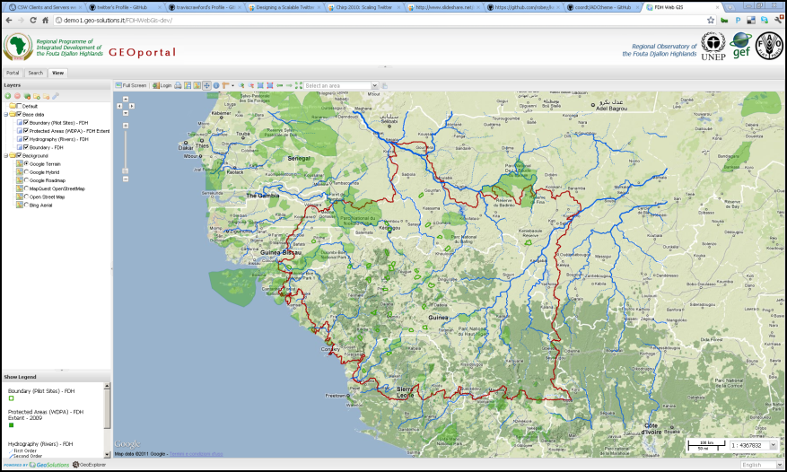
Apache HTTP
Static HTML Pages
Apache Tomcat
GeoNetwork
GeoServer
Metadata
Shapefile
GeoTiff

Slide 2
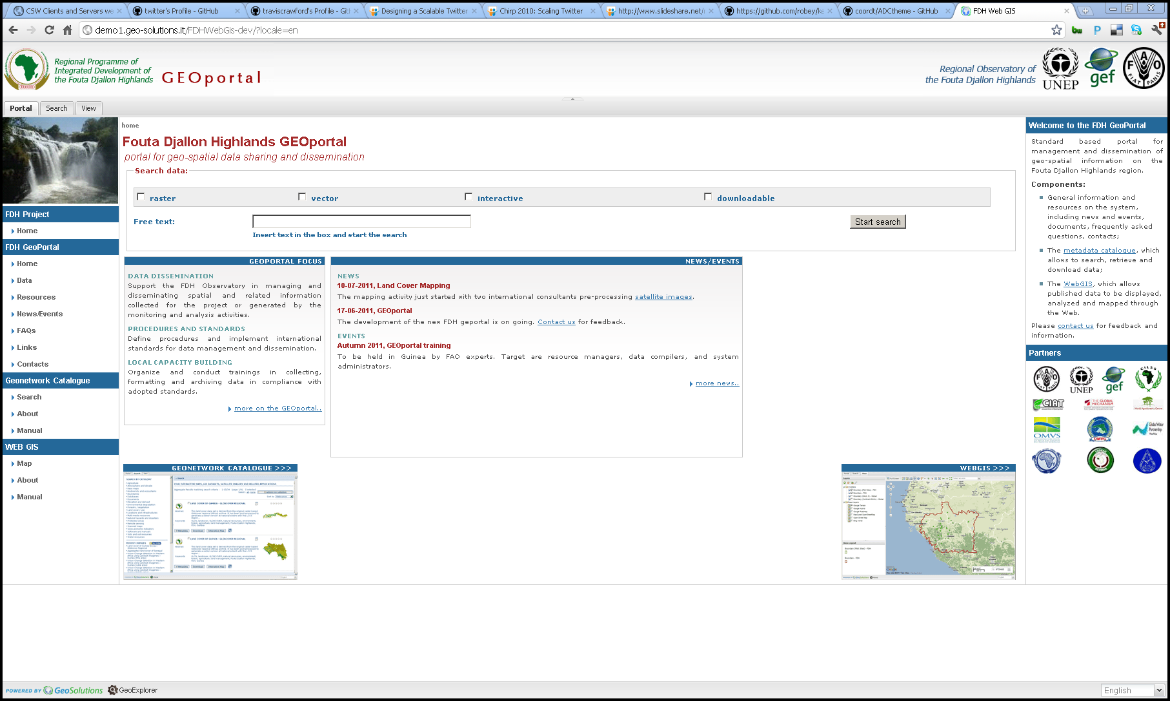
Additional resources and manuals
Simplified Search
News and other dynamic information
Link To Search Tab
Link To View Tab

Slide 3
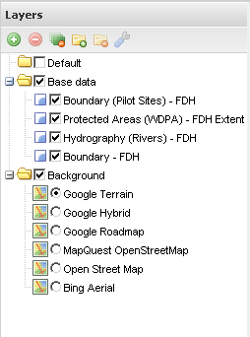
Add WMS Layer
Remove Selected Layer
Remove All Layers
Remove Layer Group
Add Layer Group
Layer Properties Panel
Default Layer group
Layer group
Background Layer switcher

Slide 4
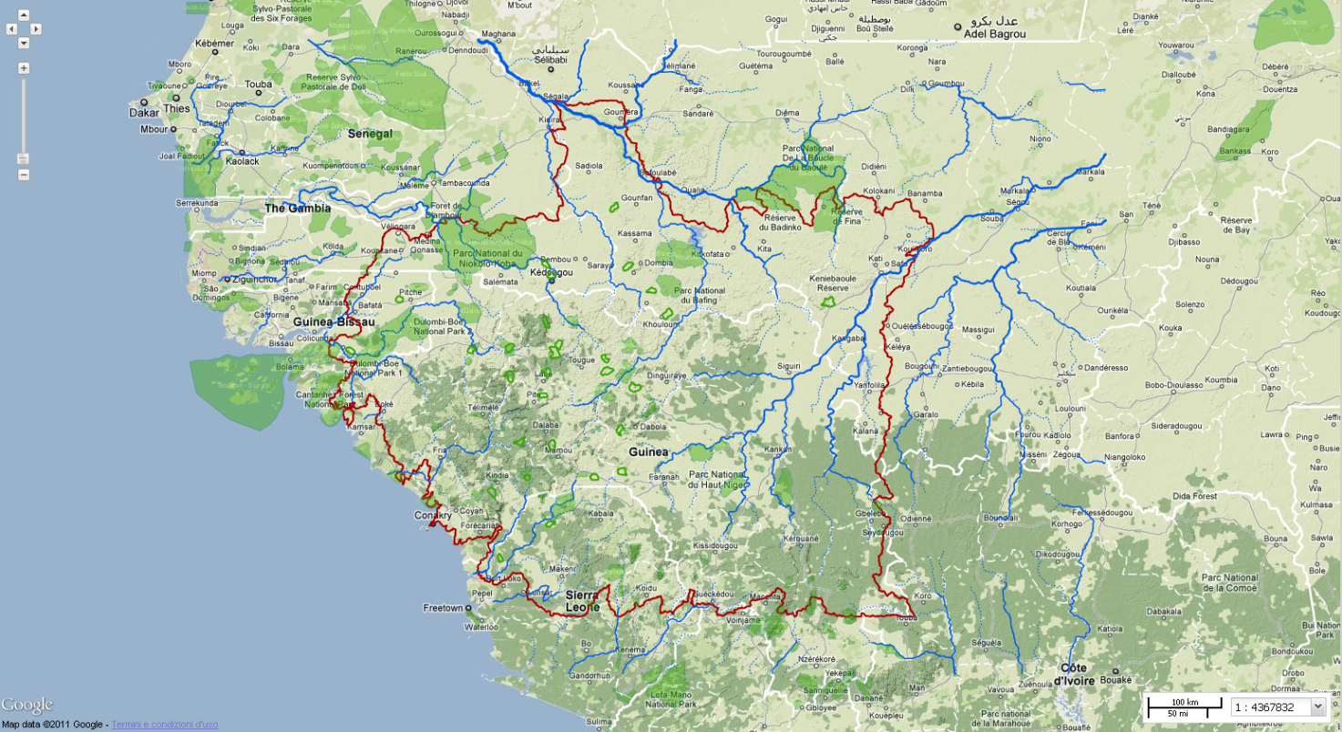
Pan Controls
Zoom Slider
Scale Control

Slide 5
Main Toolbar
Layers Tree Panel
Legend Panel
Multilingual Dropdown
Map Component

